Slide 1
Visual arts proposals
By: Miguel Cuéllar

Slide 2
New forms of painting proposal:

Slide 3
Concept:
The concept that will be used for the painting will be the historical corruption in Colombia, the art piece will be centered on the relation with the multinationals and their economic and political influences in the country.

Slide 4
Inspiration
For the proposal, the artist in which the painting will be influenced is Antonio Caro, he is a Colombian conceptual artist whose art centers in depicting the main problems of Colombia and a critique to them. The painting chosen for the inspiration is “Colombia-Coca-Cola”, which depicts the great American economic and political influence on Colombia .

Slide 5
Sketch
As with the inspiration, the sketch will depict the big American influence on the Colombian politics and economy. But will depict it in a historical view of Colombia, with the context of the United Fruit Company. Also the violence caused by it will be shown, since that specific company has historically been related with it.

Slide 6
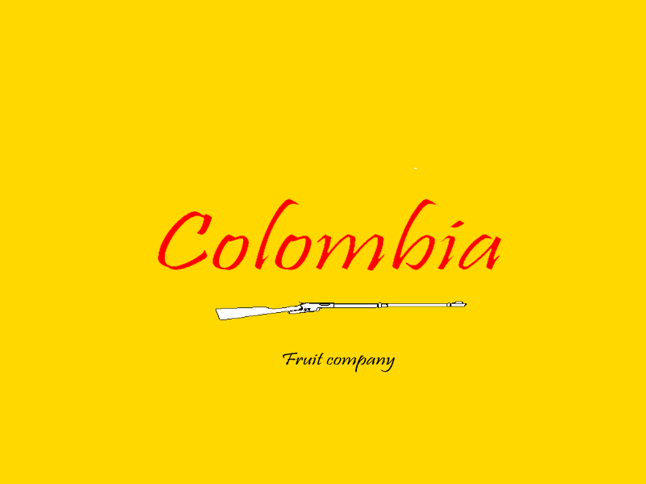
Sketch:

Slide 7
New forms of sculpture

Slide 8
Concept:
The concept that will be used in the planned sculpture will be the irony and it´s possible bizarre expressions. This will be done through the object intervention focused on the colours of the object an it´s context.

Slide 9
Inspiration
The main inspiration for this proposal is Bernardo Salcedo. He is a Colombian artist that has two main focuses in his works: the demonstration and critique of the main moral and political issues in Colombia and the irony of everyday objects through object intervention and a change of their context. The sculpture chosen was “Swing” an object intervention of a golf club, that as said before simply shows the irony of that object in that context.

Slide 10
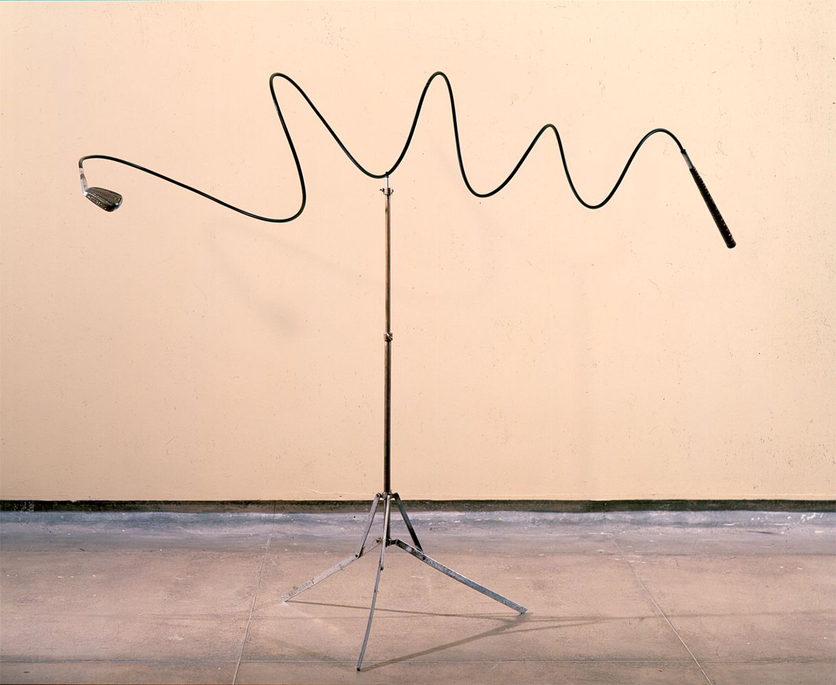
Inspiration

Slide 11
Sketch
For the sketch, the concept of irony and change of context in obkects will be used. An object intervention will be done, but it won´t be through an abrupt change of proportions and sizes, instead it will be a subtle change of the context and of some colours. Those subtle changes will have a bigger relationship with Dada than with the artist chosen, but the proposal is still conceptually related to the artist.

Slide 12
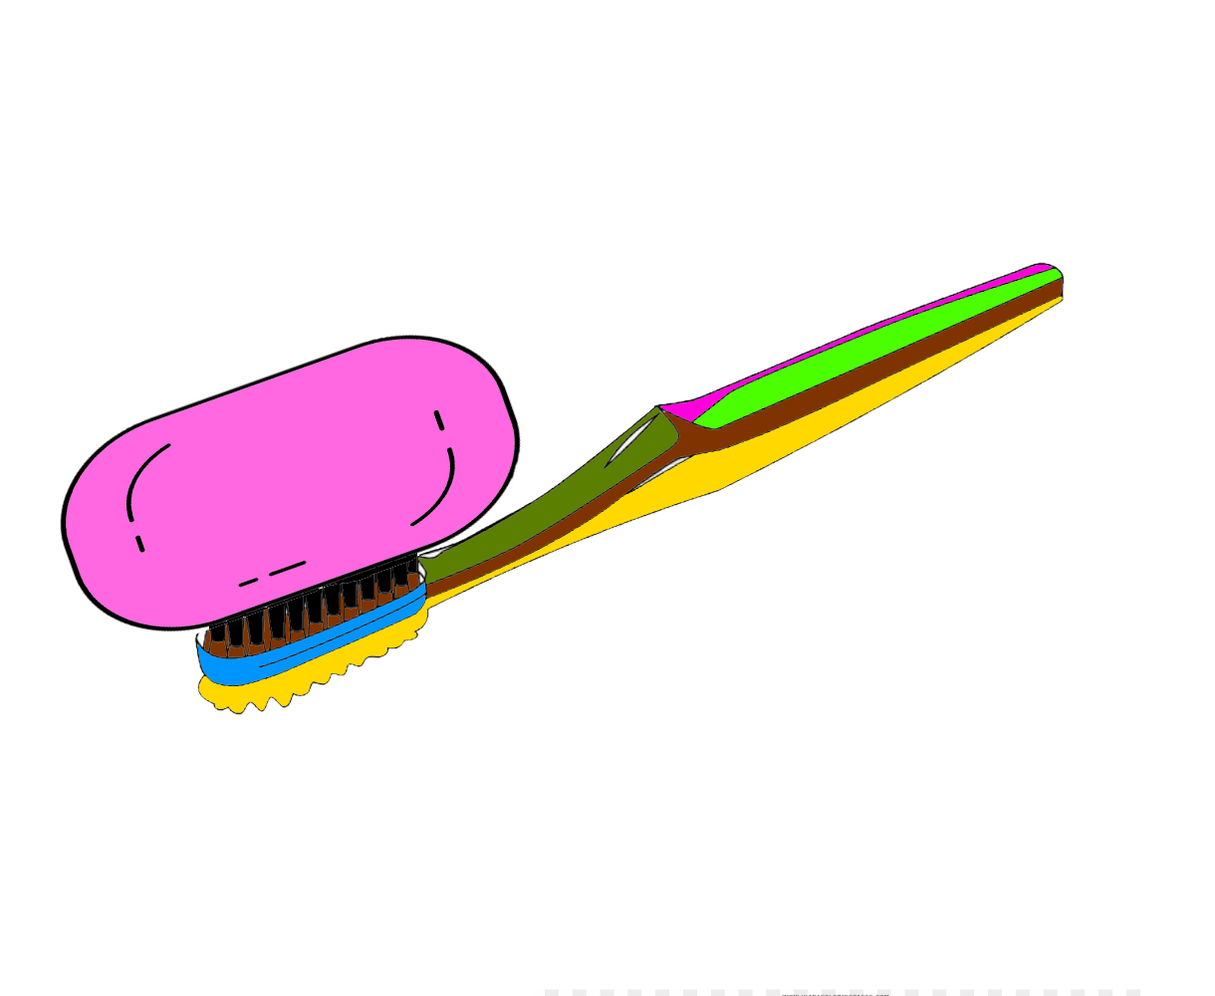
Sketch:

